Slide 1





















SwarmGenomics PuTTY Instructions
ATGCTTCGCGAACGTACGTCGCGAACATTATGCTTCGCGAACGTACGTACGTAGGT

Slide 2
PuTTY to access virtual machines
PuTTY is a free SSH client that allows Windows users to securely connect to virtual machines or remote servers
These instructions are designed for accessing De.NBI machines but can be adapted to other servers as well
Mac and Linux users can use the terminal to login with the command:
ssh -i /path/to/your/ssh/private/key ubuntu@123.456.78.90 -p 12345

Slide 3
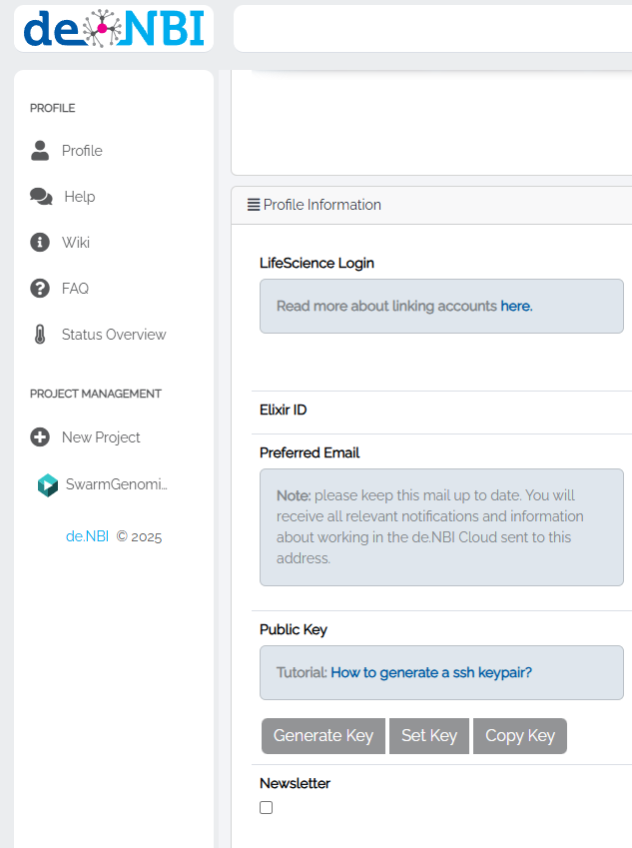
Generate key
https://cloud.denbi.de/portal/webapp/#/userinfo

Slide 4
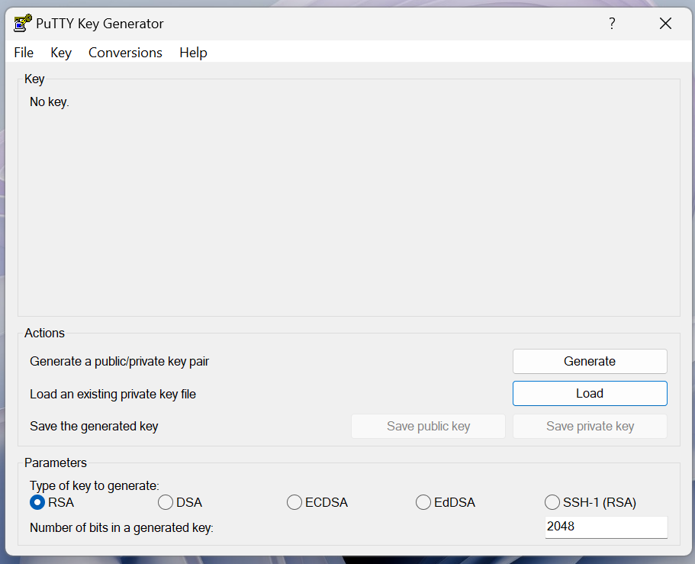
PuTTY KeyGen to load your pivate key and change format
Save to your personal drive, and save a copy online!
This can be also used to generate public/private key pair if not using De.NBI

Slide 5
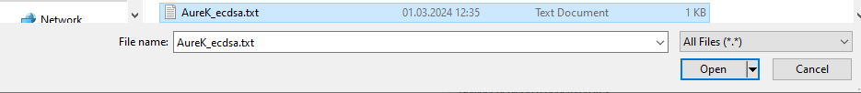
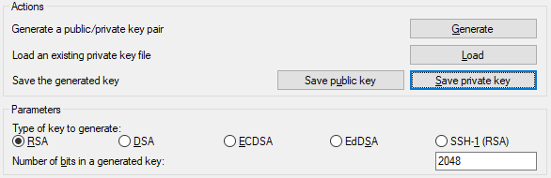
Load the private key you generated on deNBI
Change to all file types
Save private key

Slide 6
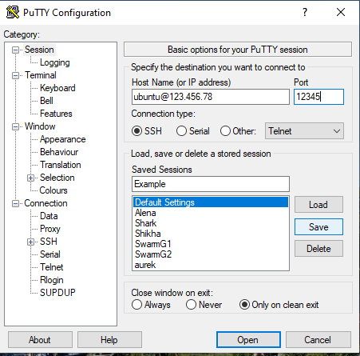
To login on PuTTY
Change these according to the VM specifications

Slide 7
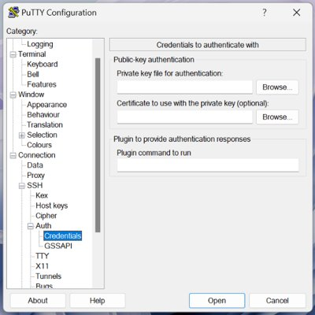
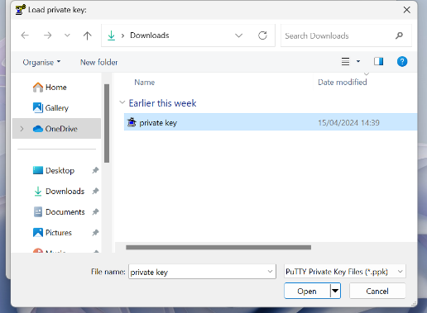
Select the private key

Slide 8
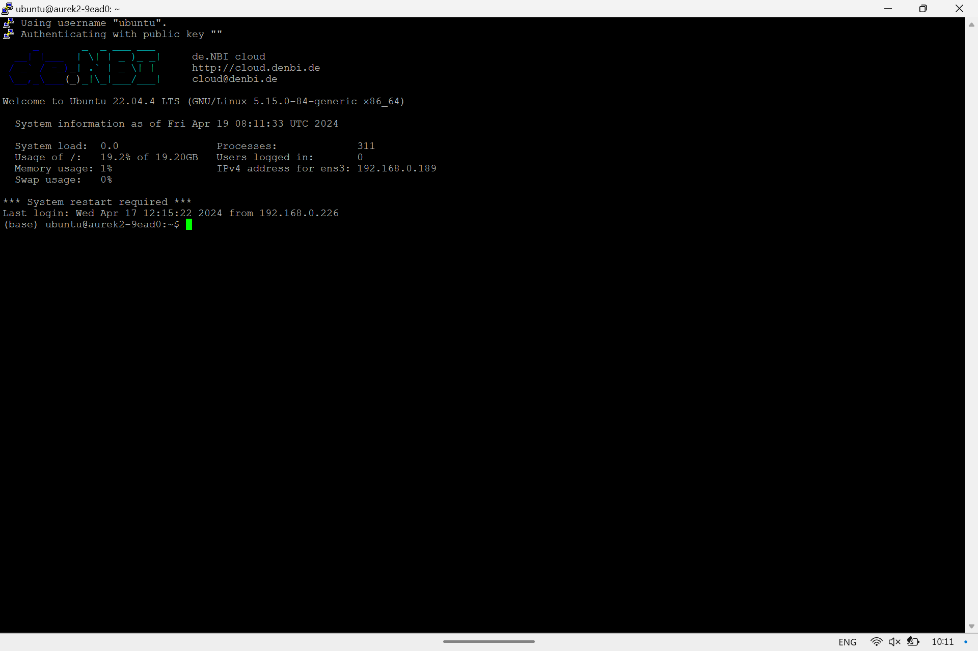
Save the information again and open

Slide 9
Make a directory for yourself
Change directory to swarmgenomics
cd /vol/storage/swarmgenomics
Make a directory for yourself
mkdir your_name (eg. aure_k)
Change directory to your own directory
Now you have your own directory and can get started with actual data!

Slide 10
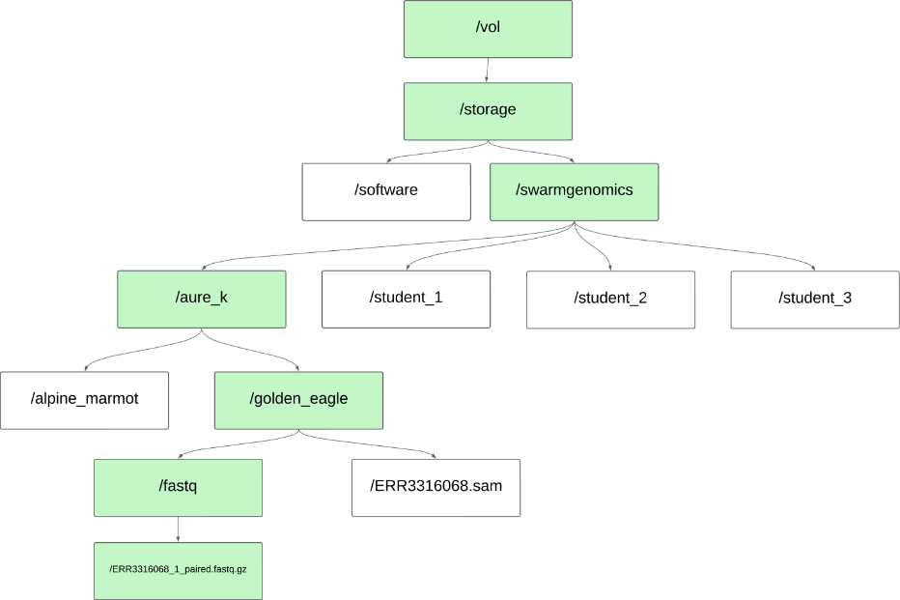
Working directory = /vol/storage/swarmgenomics/aure_k/golden_eagle

